Slide 1
Business & Accounting
Grade 10 & 11
Shortnotes

Slide 2
Petty Cash Book

Slide 3
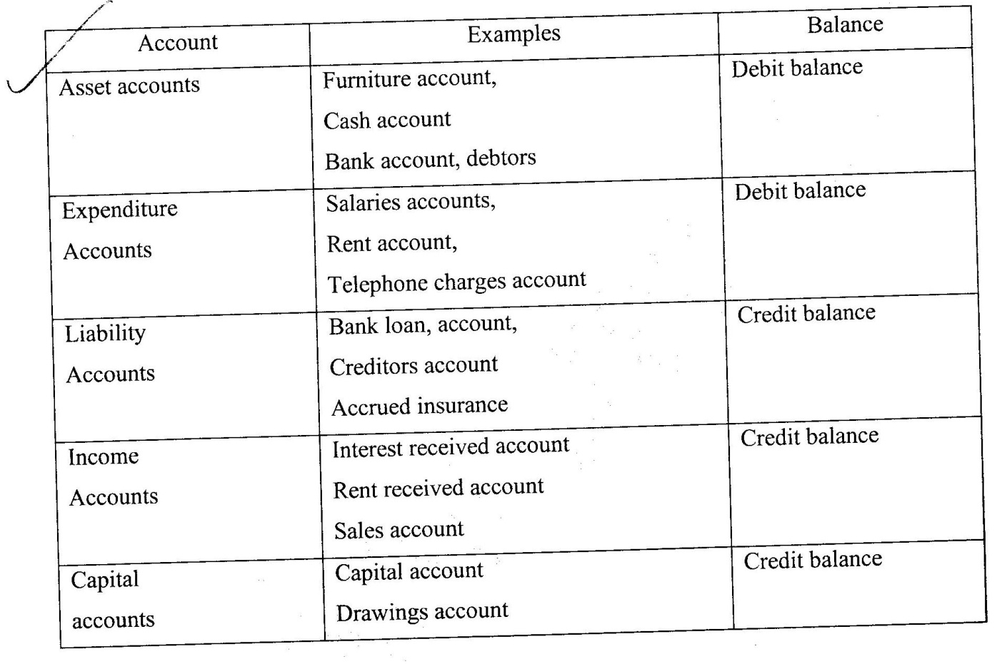
Double Entry Principles

Slide 4
Trading Account

Slide 6
Profit & Loss account and Balance Sheet

Slide 7
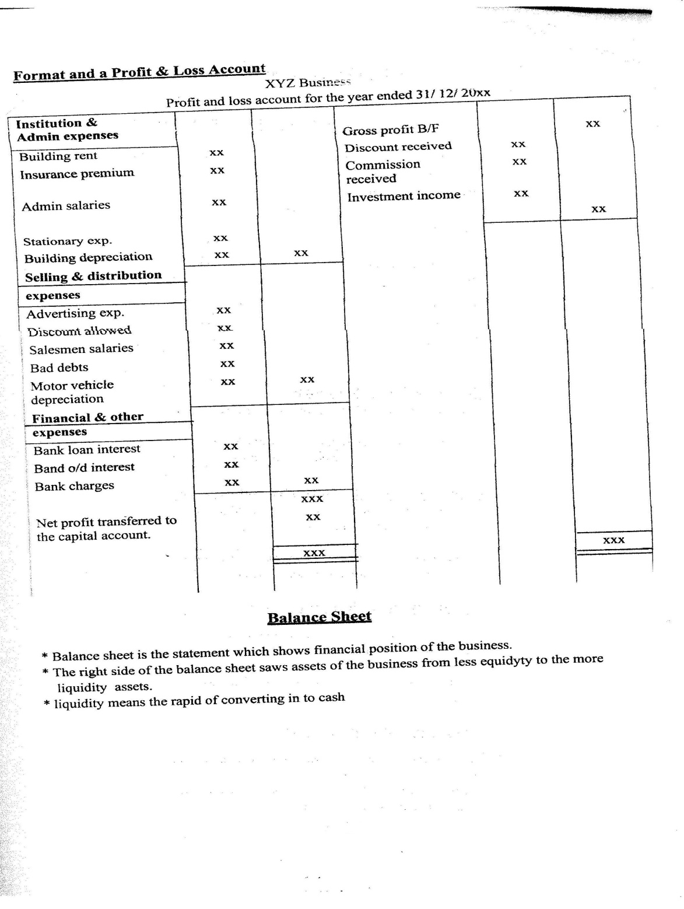

Slide 9
Questions

Slide 10
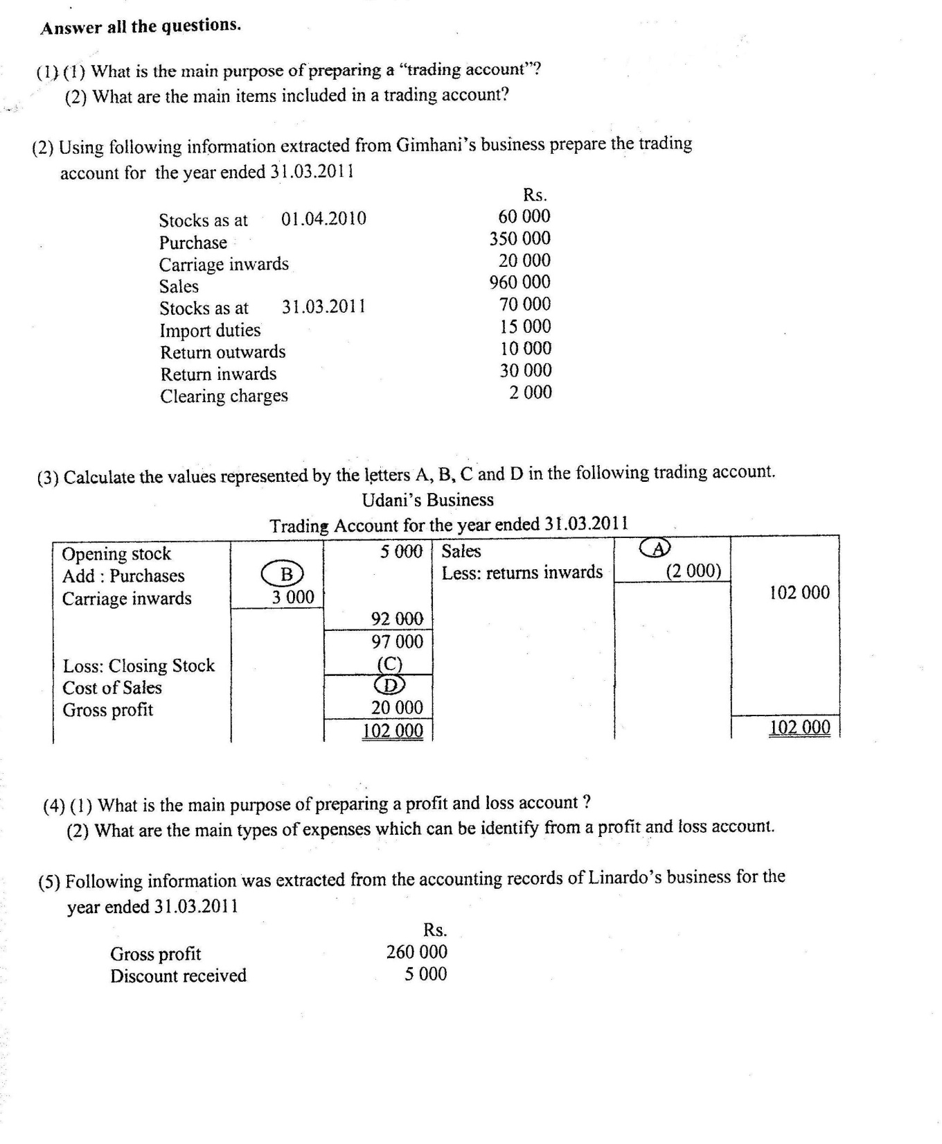

Slide 11
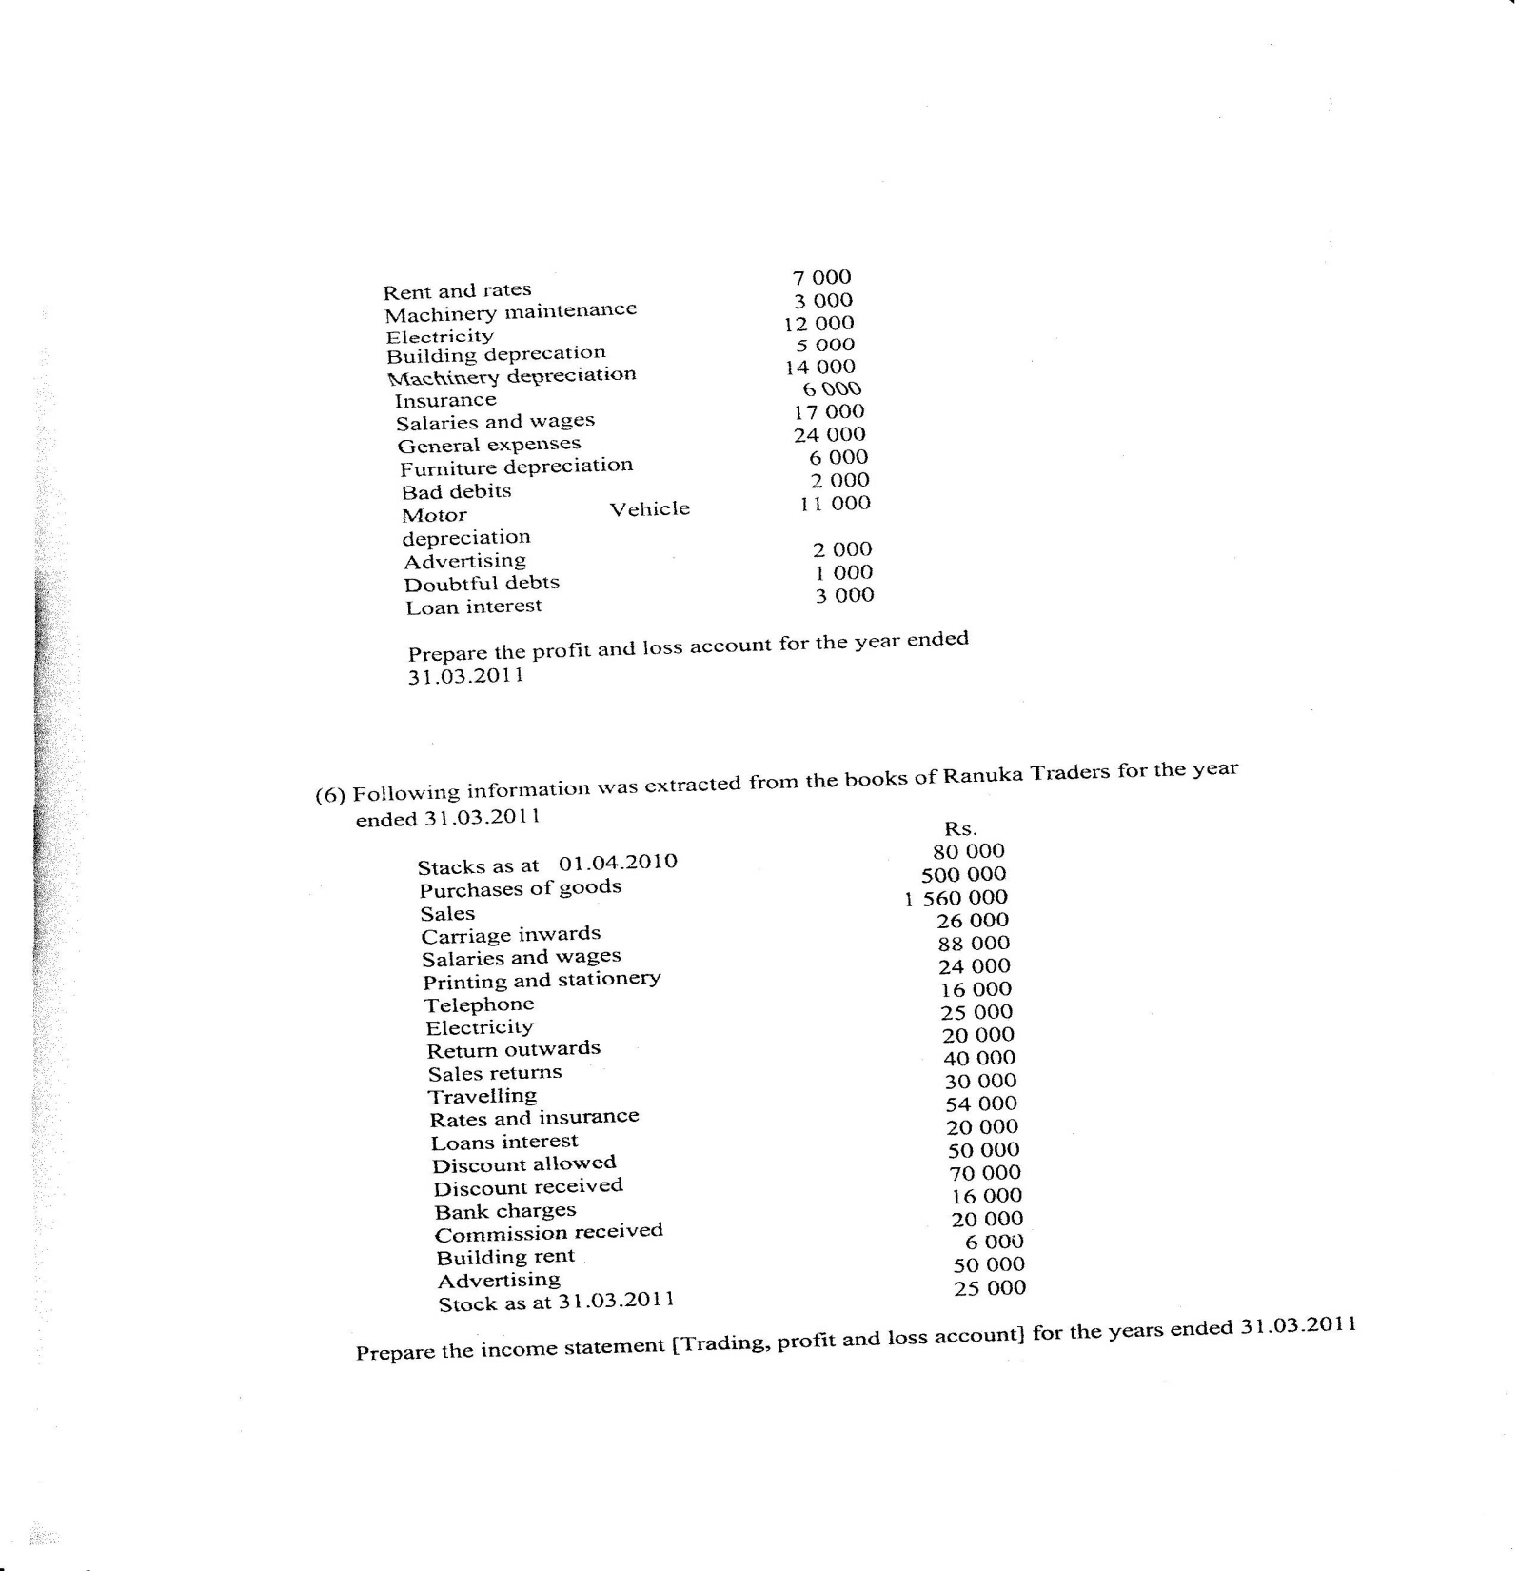

Slide 12
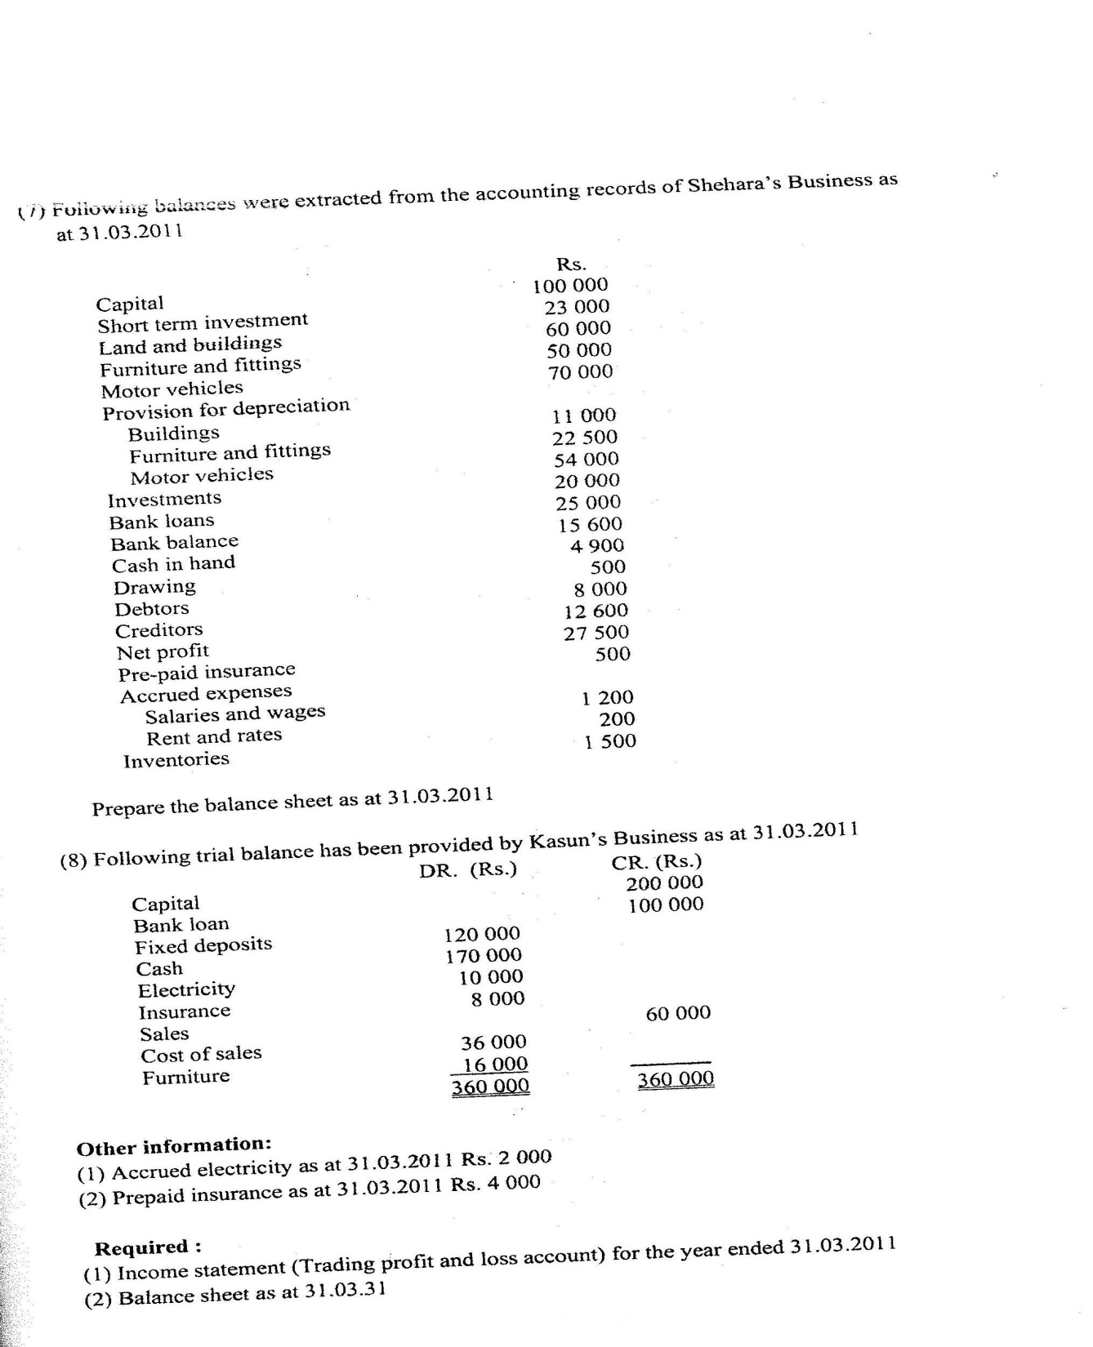

Slide 13
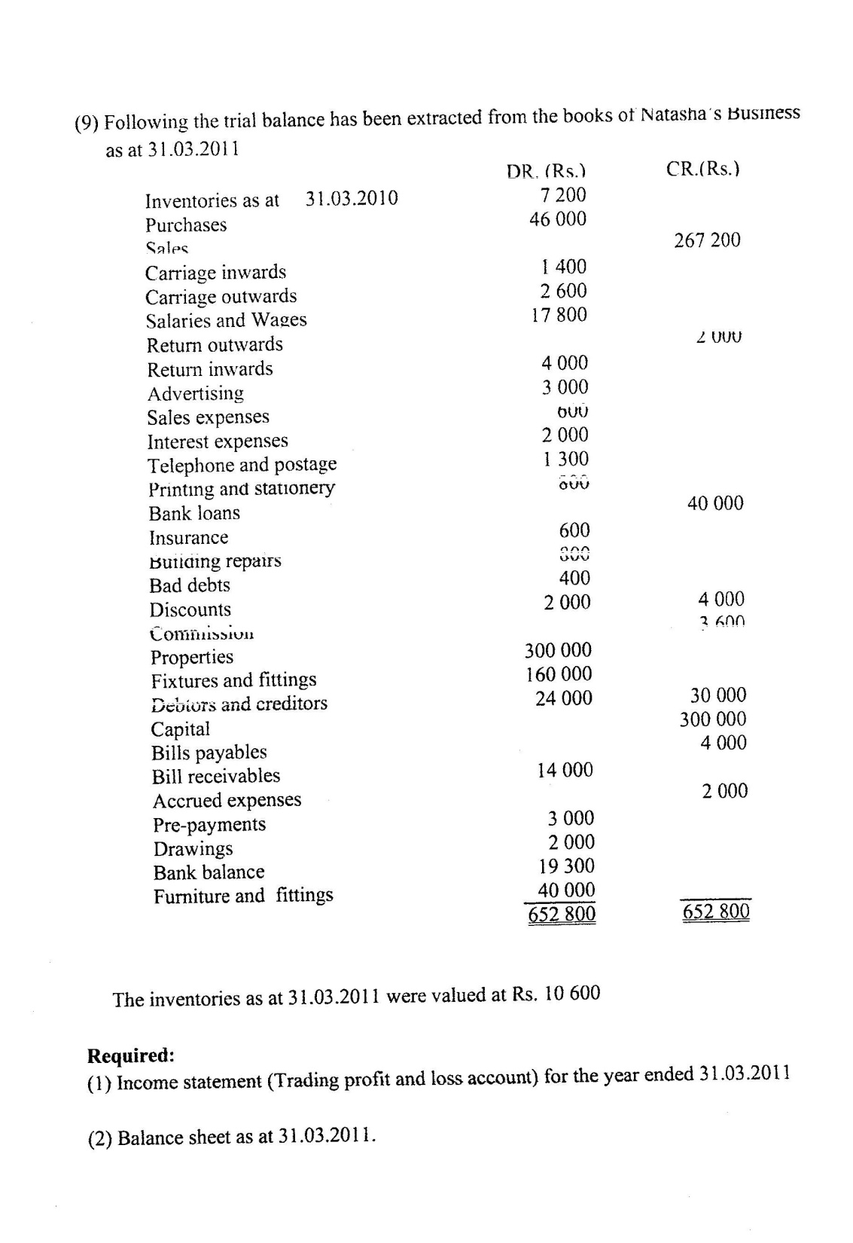

Slide 14
