Slide 1
Information and Communication Technology
Shortnotes

Slide 2
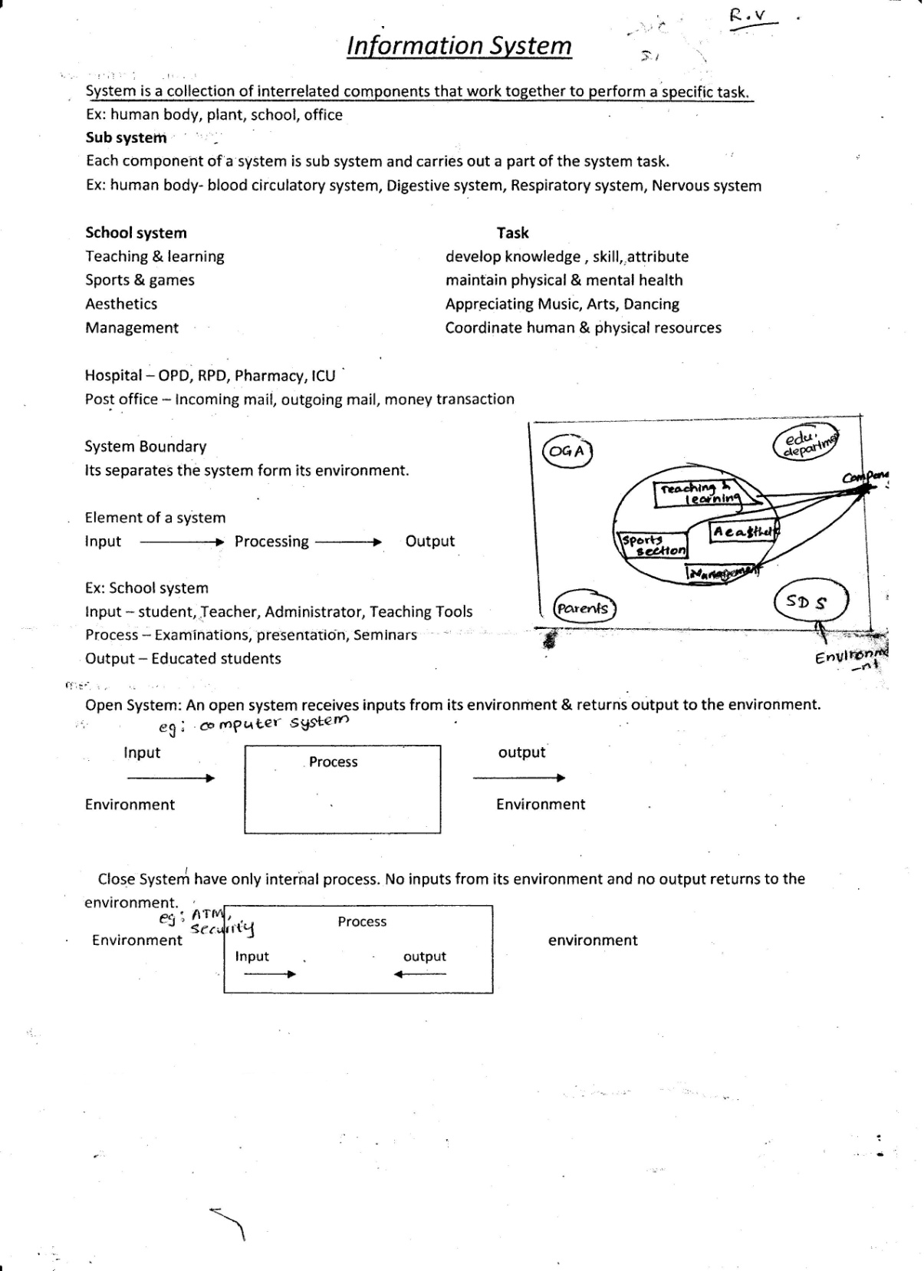

Slide 3
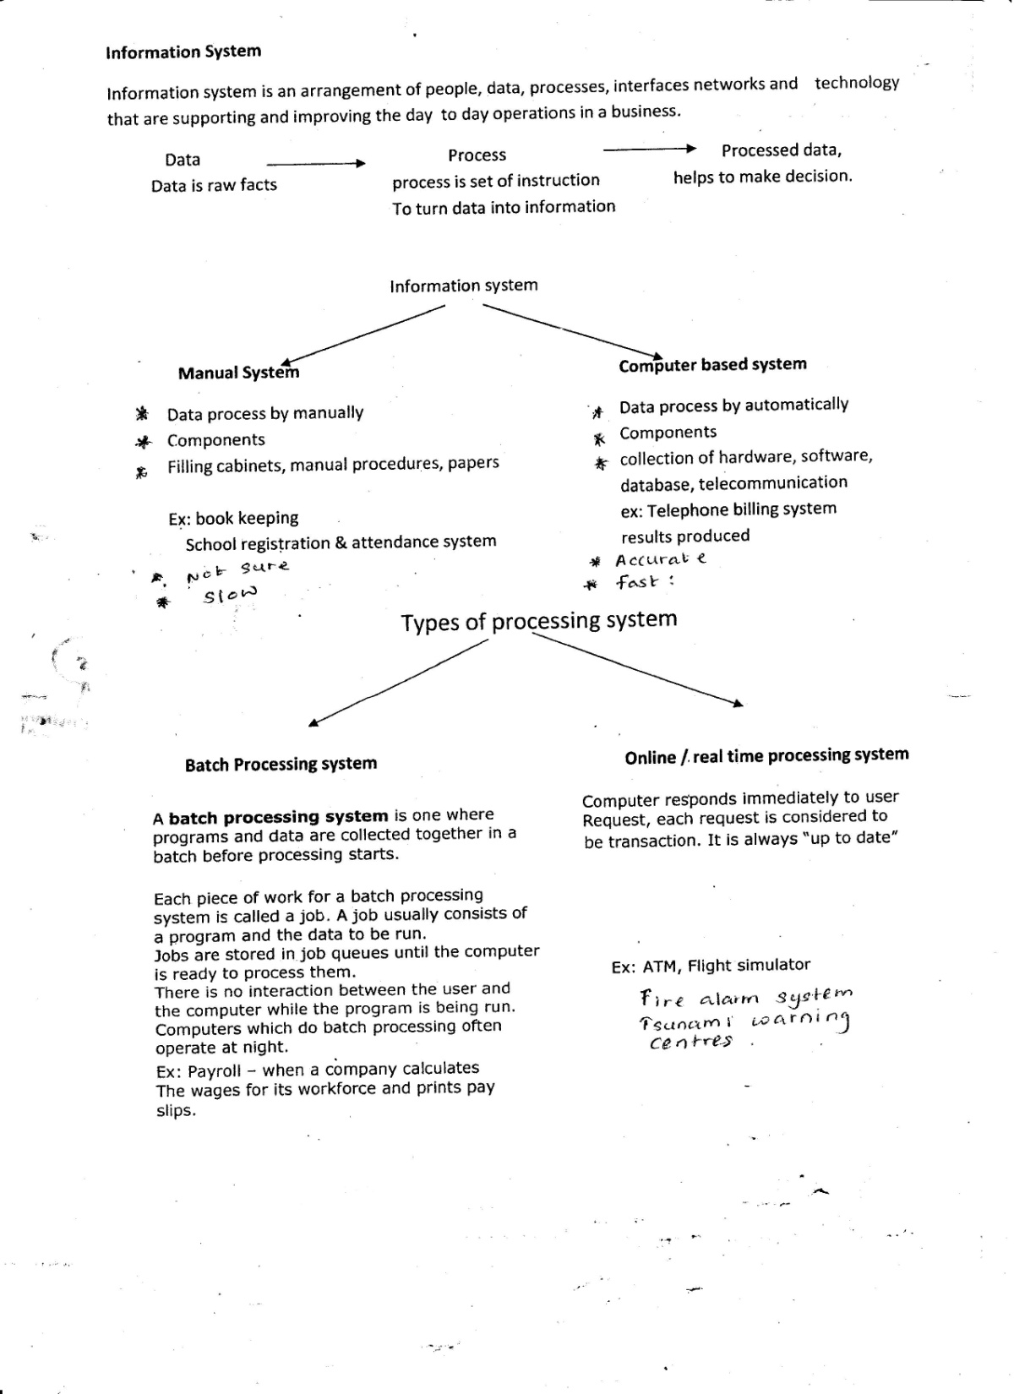

Slide 4
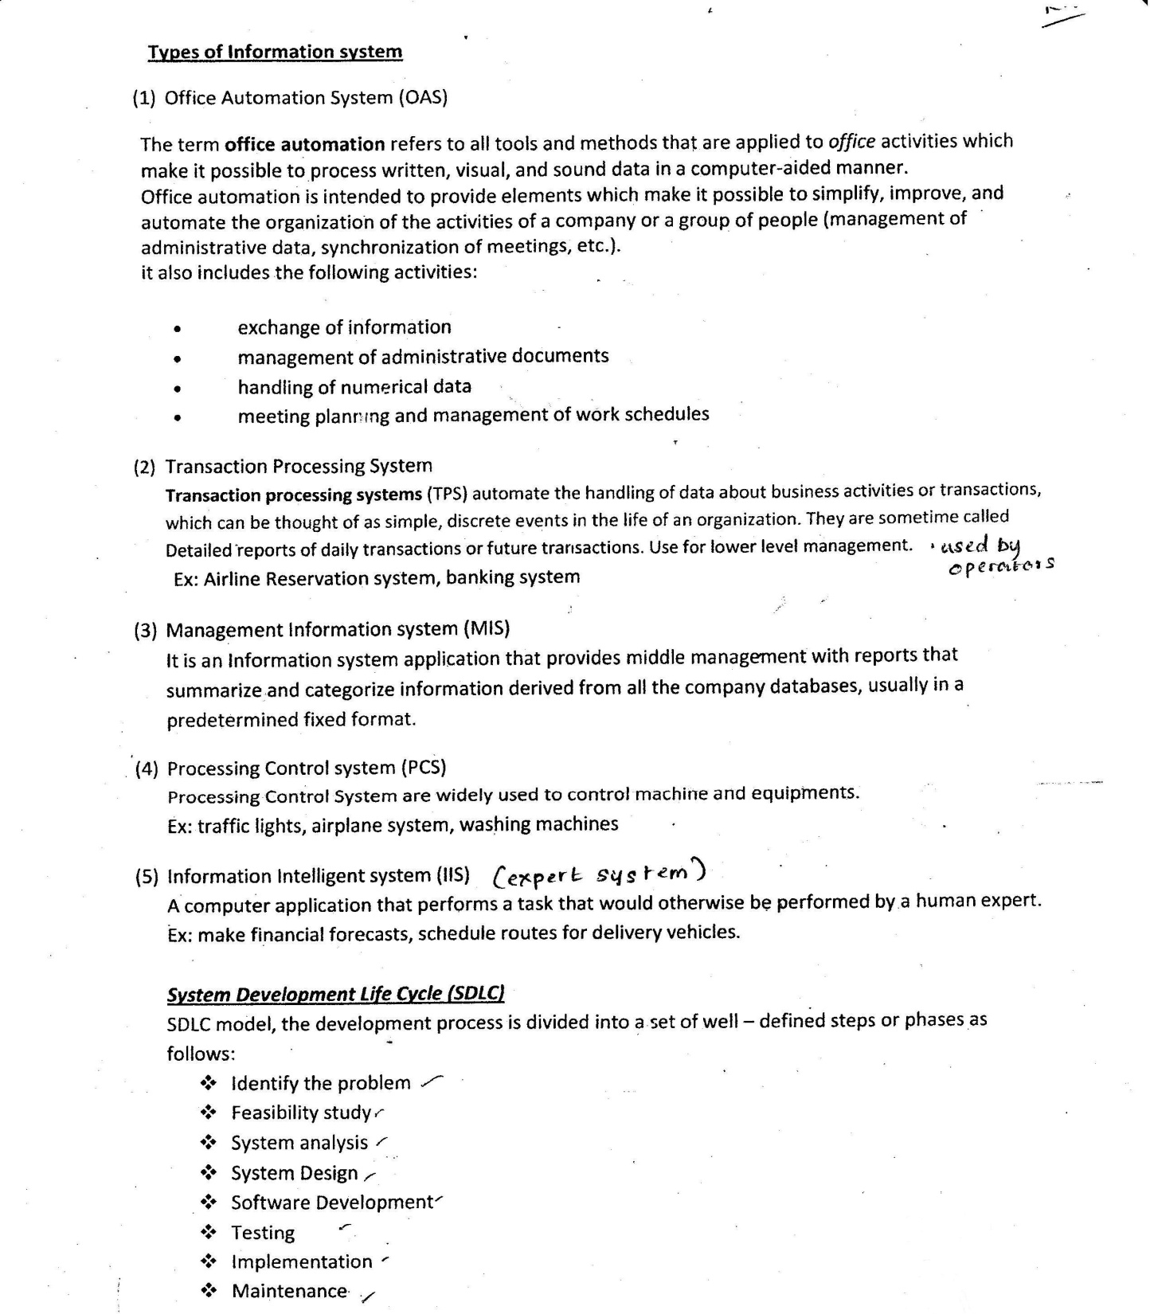

Slide 5
